Slide 1

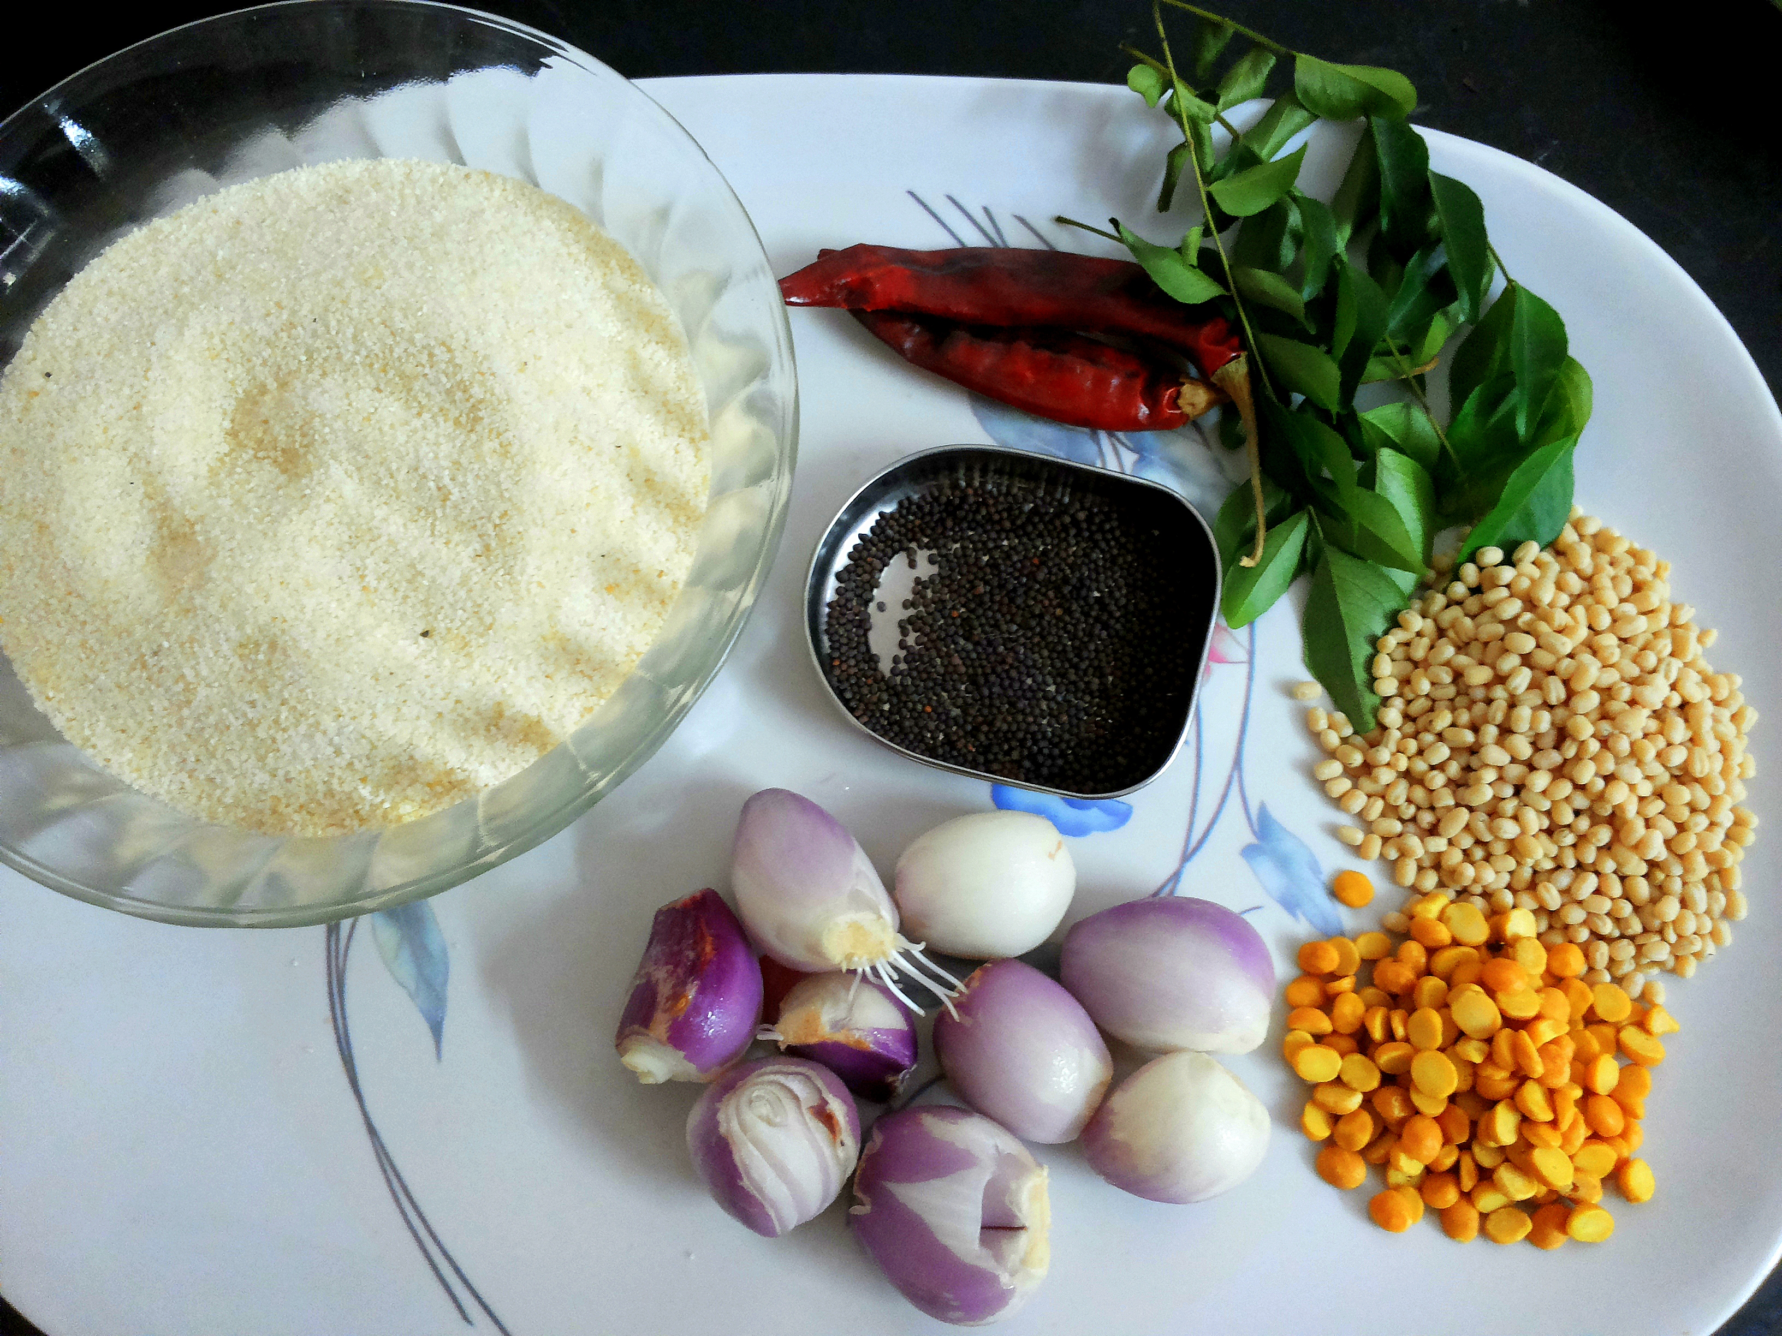

Slide 2
If earthquake vibrations can be separated into "ingredients" (vibrations of different speeds & amplitudes), buildings can be designed to avoid interacting with the strongest ones.
If sound waves can be separated into ingredients (bass and treble frequencies), we can boost the parts we care about, and hide the ones we don't. The crackle of random noise can be removed. Maybe similar "sound recipes" can be compared (music recognition services compare recipes, not the raw audio clips).
If computer data can be represented with oscillating patterns, perhaps the least-important ones can be ignored. This "lossy compression" can drastically shrink file sizes (and why JPEG and MP3 files are much smaller than raw .bmp or .wav files).
If a radio wave is our signal, we can use filters to listen to a particular channel. In the smoothie world, imagine each person paid attention to a different ingredient: Adam looks for apples, Bob looks for bananas, and Charlie gets cauliflower (sorry bud).

Slide 3
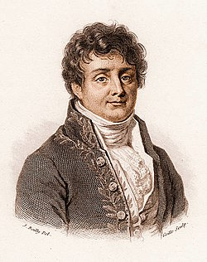
Joseph Fourier
Fourier, Joseph (1822). Théorie analytique de la chaleur. Paris: Firmin Didot Père et Fils.

Slide 4
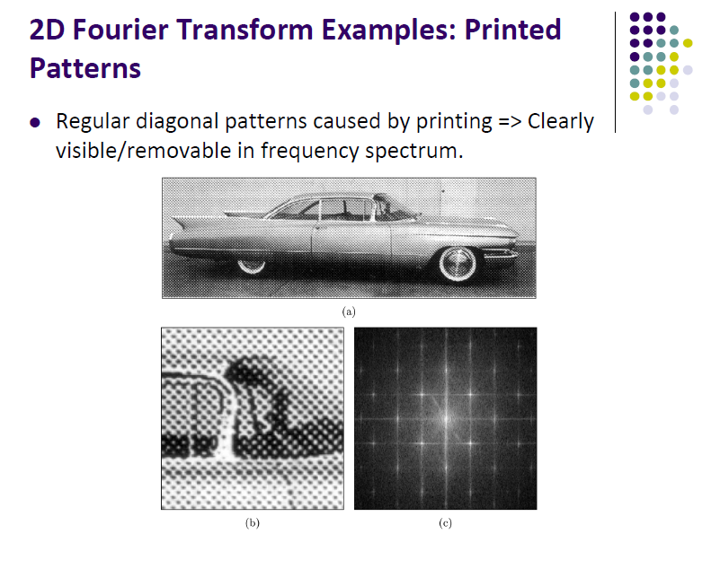

Slide 5
Continuous Fourier Transform (FT)
Transforms a signal (i.e., function) from the spatial (x) domain to the frequency (u) domain.

Slide 6
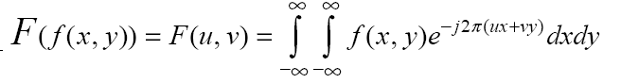
Extending FT in 2D
Forward FT
Inverse FT

Slide 7
Discrete Fourier Transform (DFT) (cont’d)
Forward DFT
Inverse DFT
1/(NΔx)

Slide 8
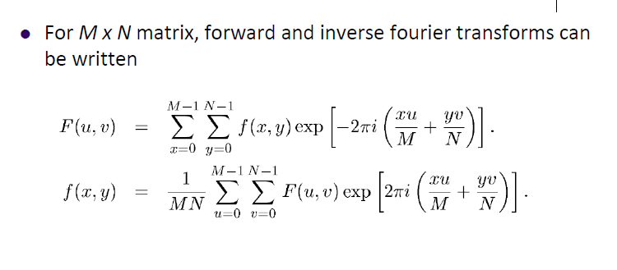

Slide 9
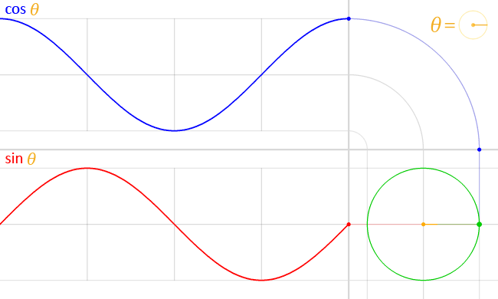

Slide 10
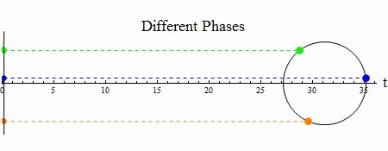

Slide 11
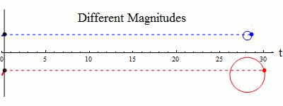

Slide 12
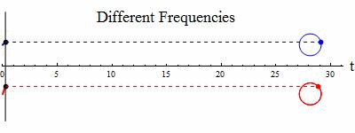

Slide 13
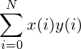
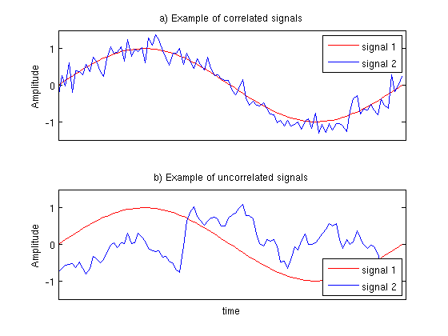
Computes the correlation between x and y
If the correlation is high, then the signals are similar, if the correlation is near zero the signals are not very similar.

Slide 14
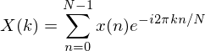
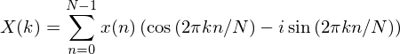
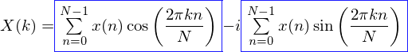
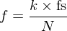
To convert these values of k into actual frequencies (measured in Hertz), we need the sampling rate of our original signal (fs) and the following formula:

Slide 15
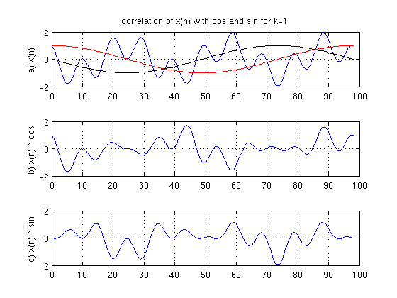

Slide 16
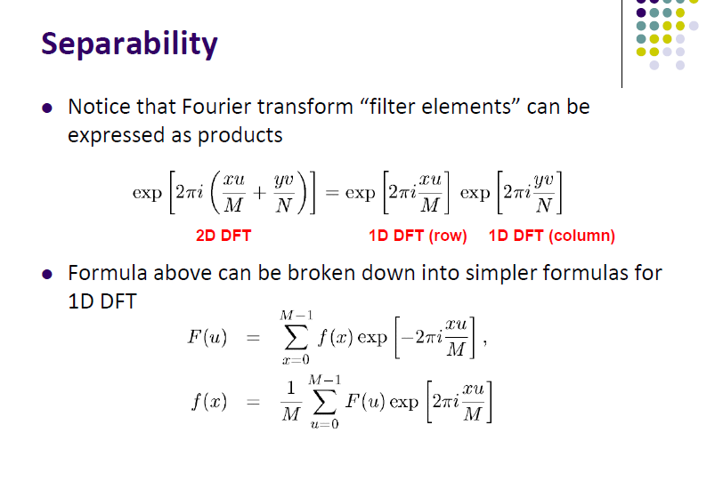

Slide 17
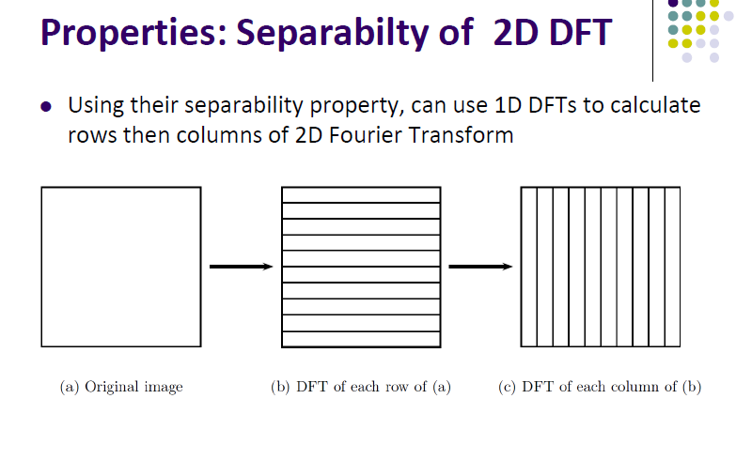

Slide 18
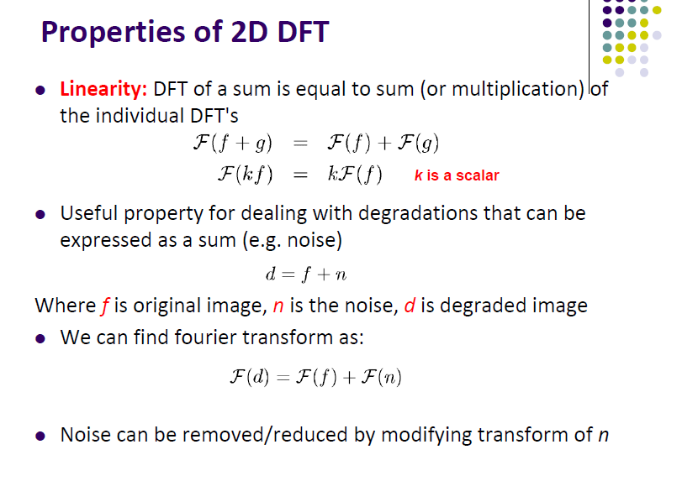

Slide 19
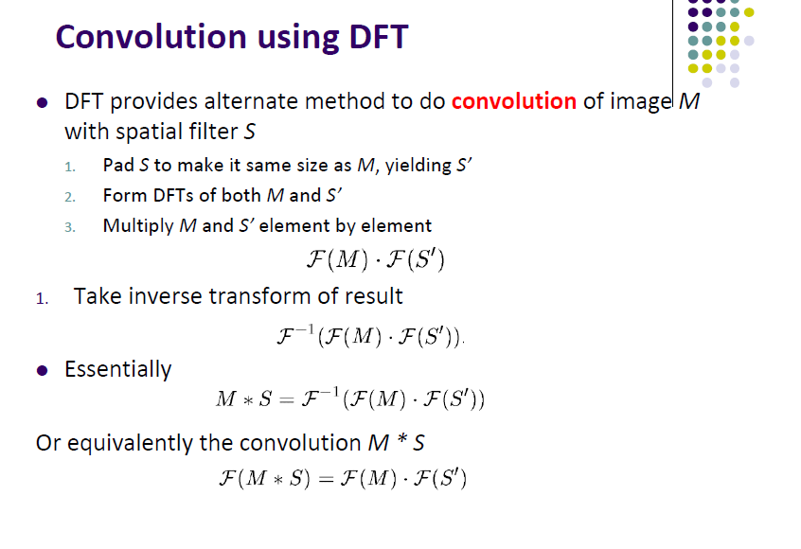

Slide 20
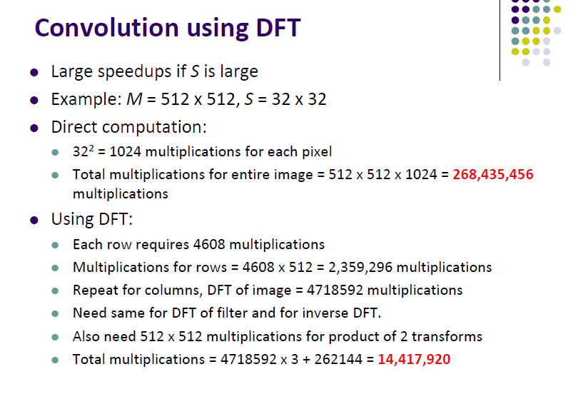

Slide 21
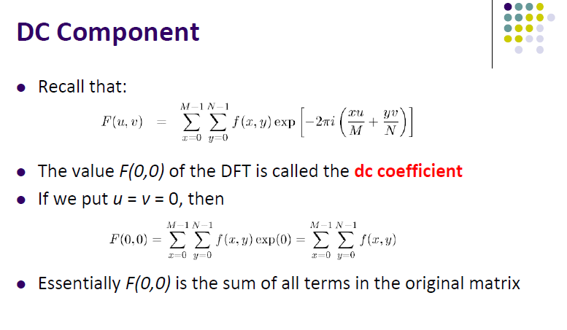

Slide 22
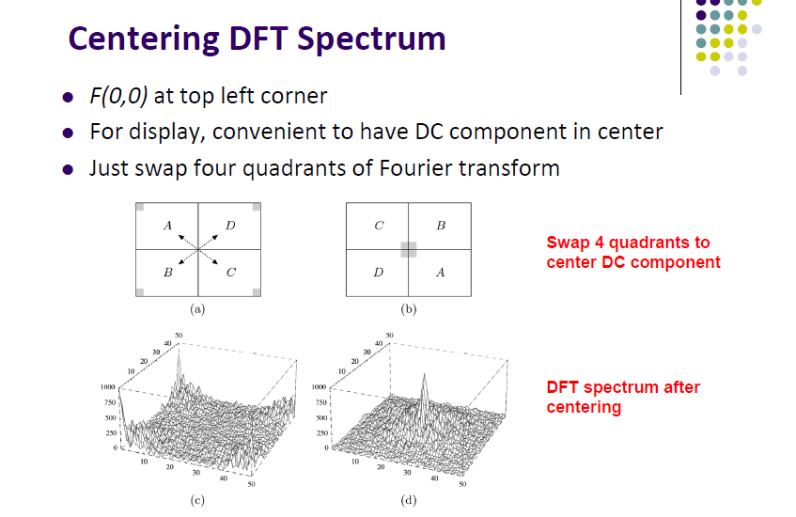

Slide 23
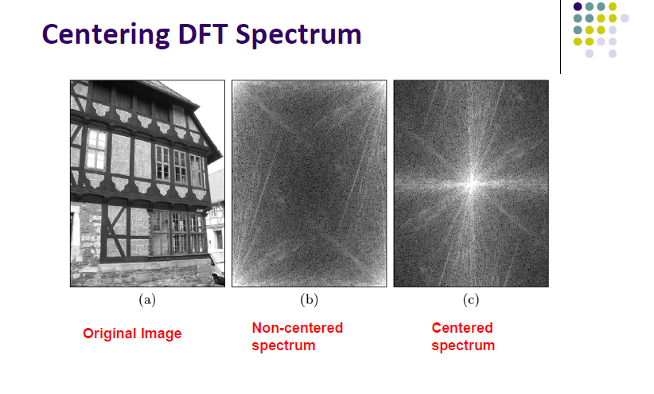

Slide 24
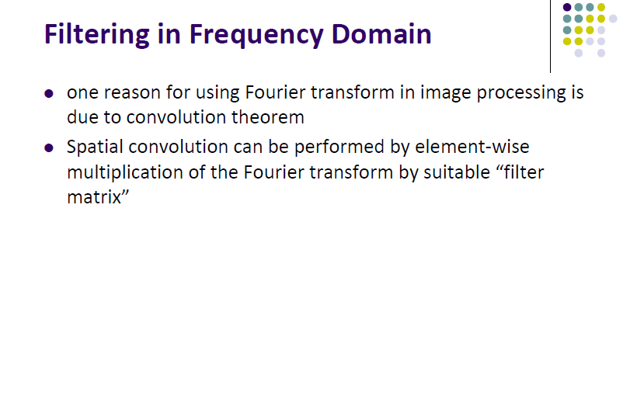

Slide 25
x(t) is a bunch of sinusoids added together. x(t) happens to be three sinusoids with frequencies of 2Hz, 3Hz, and 5Hz and amplitudes 7, 11, and 13
ω(rad/s) = 2π×f(Hz)
http://dmorris.net/projects/tutorials/fourier_tutorial.pdf

Slide 26
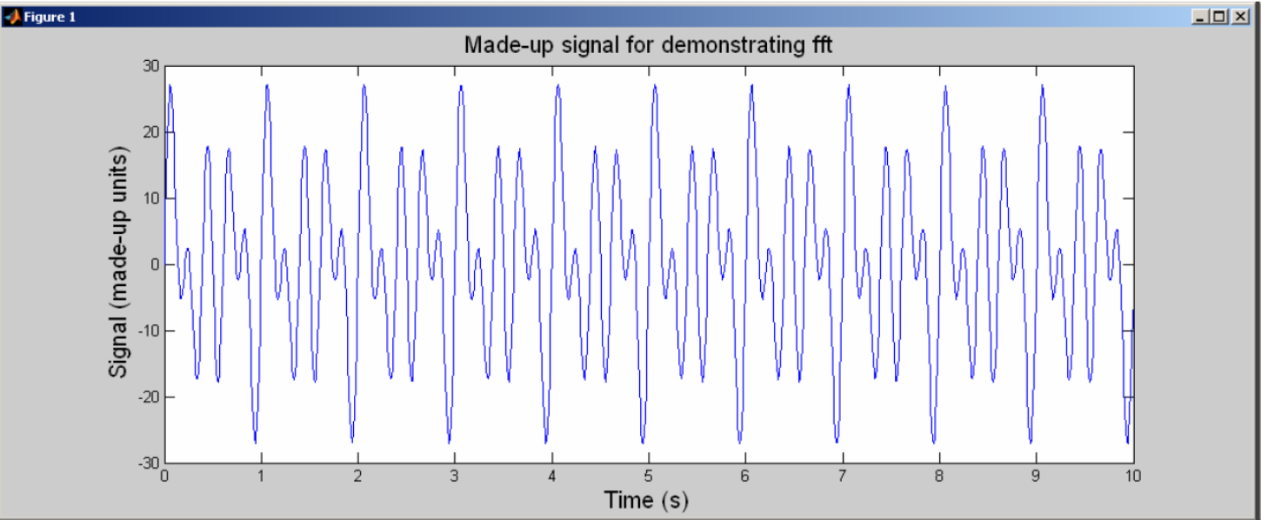

Slide 29



Slide 30
https://www.cs.unm.edu/~williams/cs530/ft2d.pdf

Slide 32
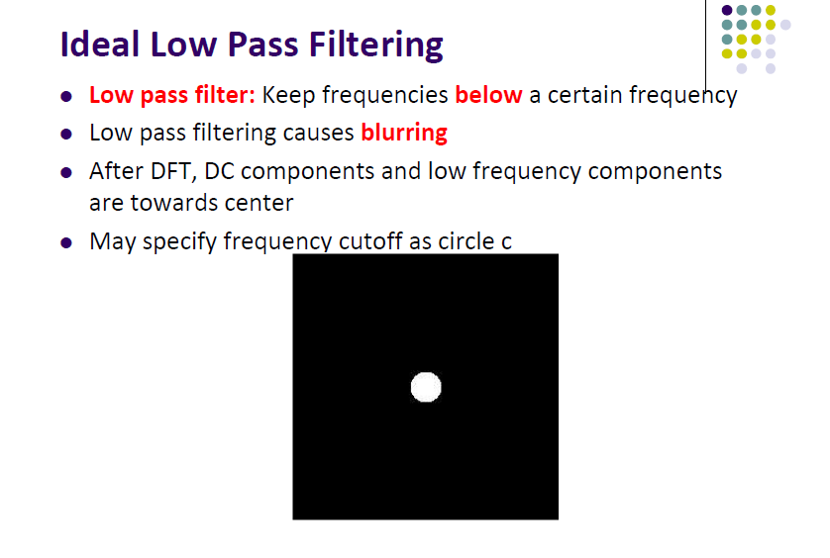

Slide 33
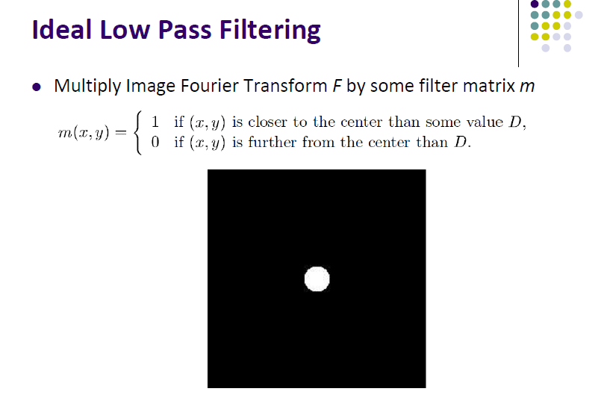

Slide 34
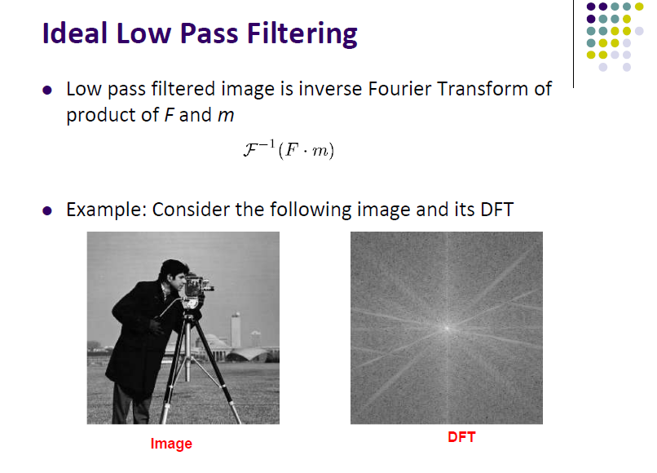

Slide 35
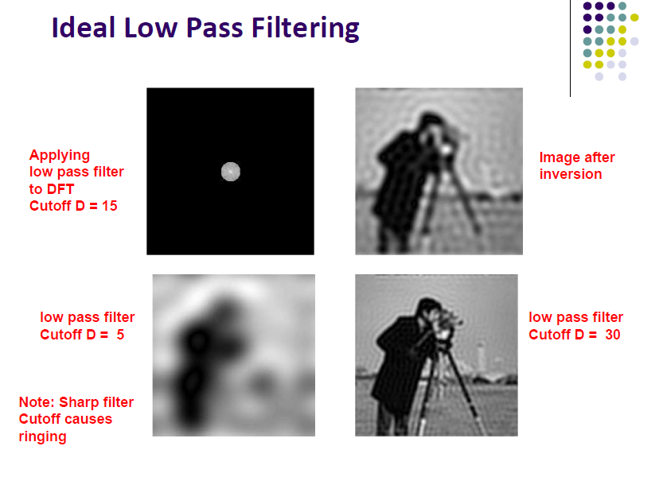

Slide 36
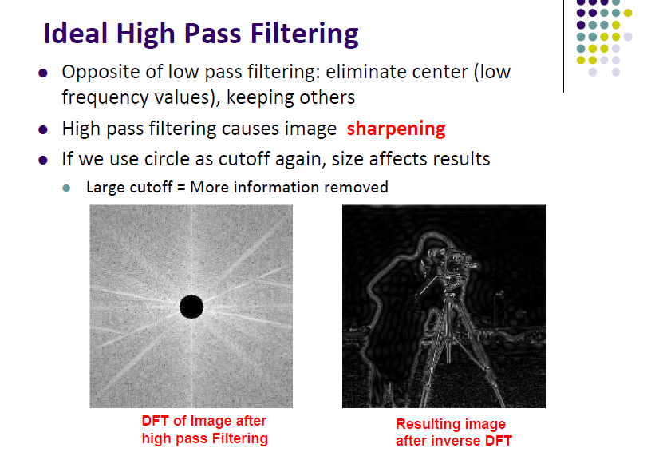

Slide 37
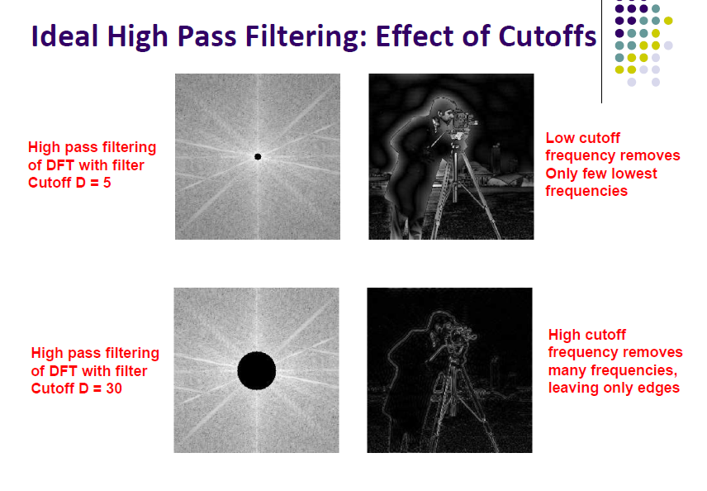

Slide 38
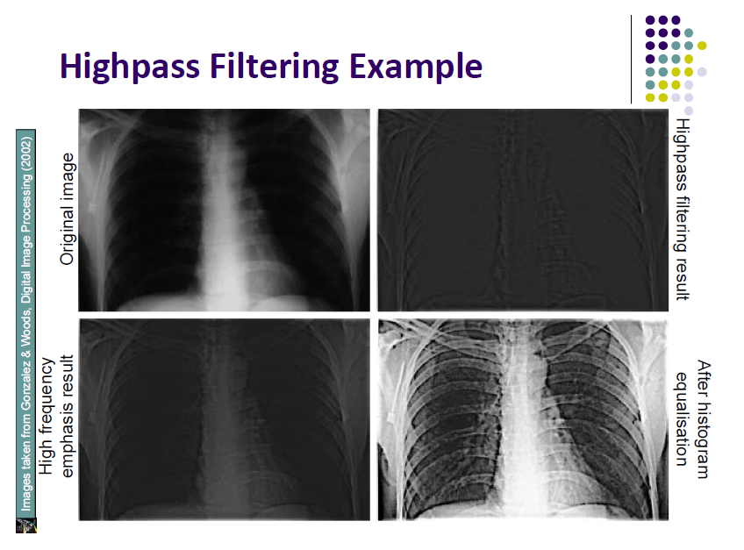

Slide 39
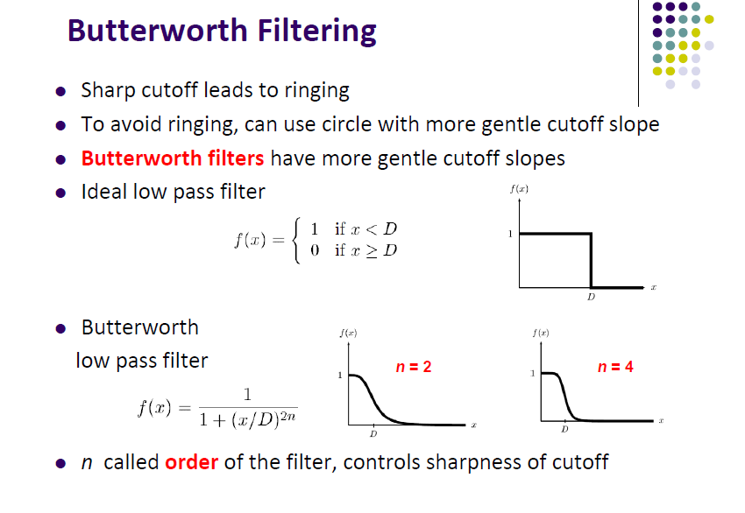

Slide 40
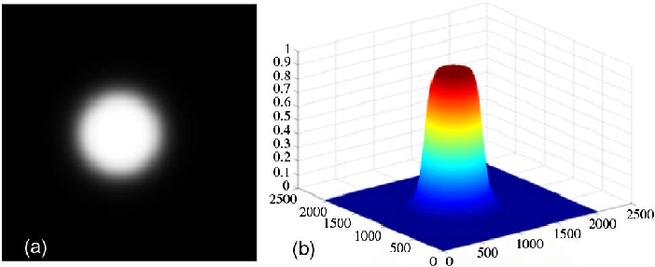

Slide 41
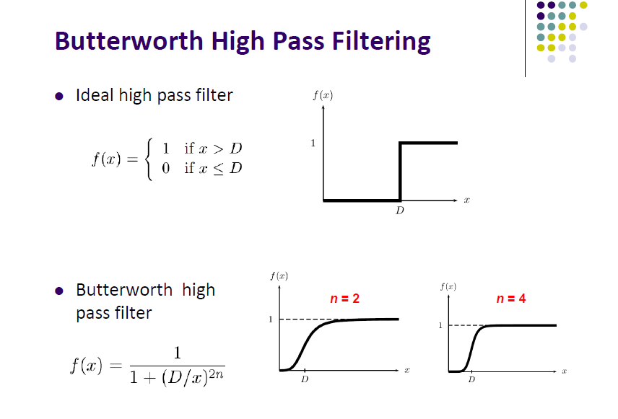

Slide 42
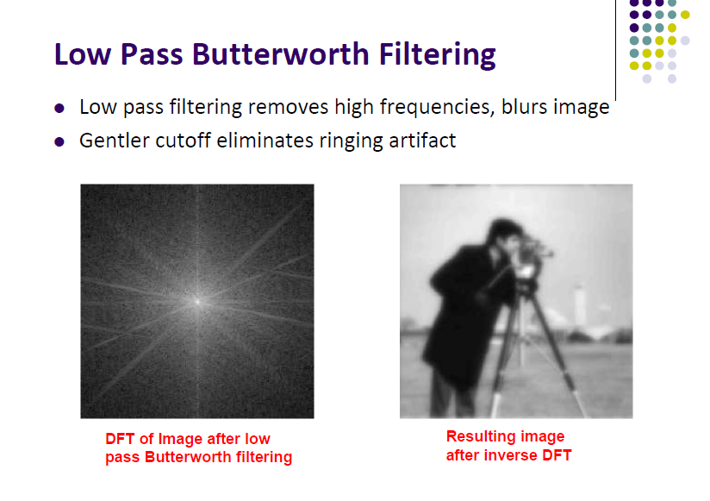

Slide 43
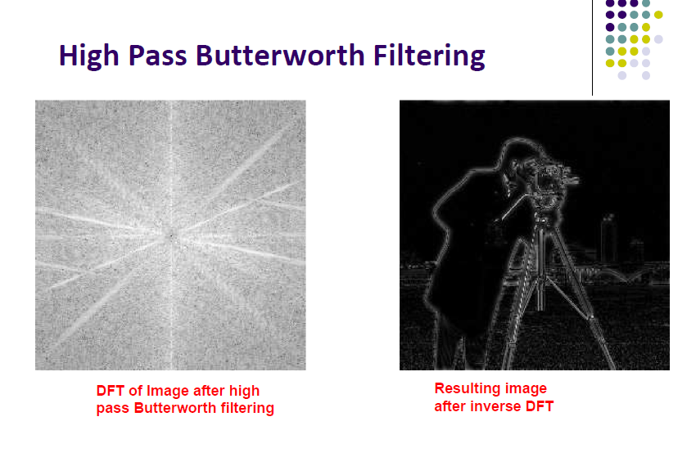

Slide 44
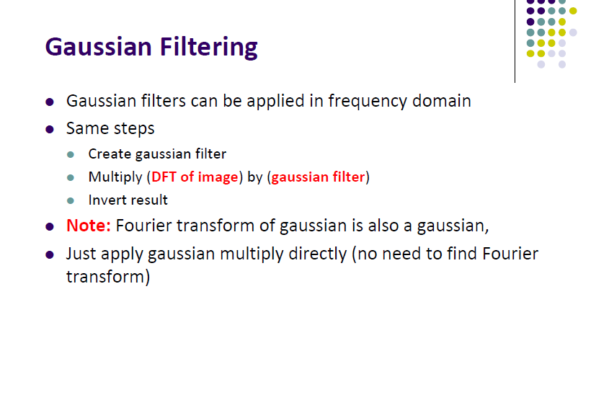

Slide 45
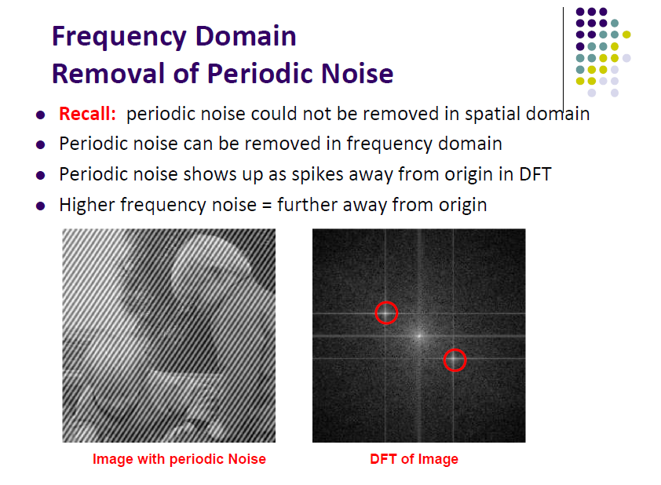

Slide 46
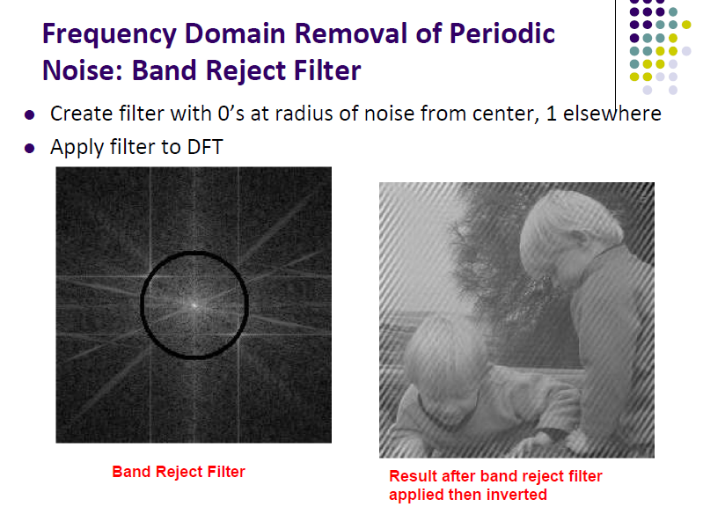

Slide 47
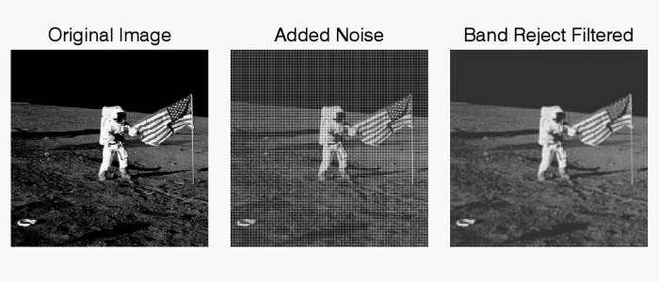

Slide 48
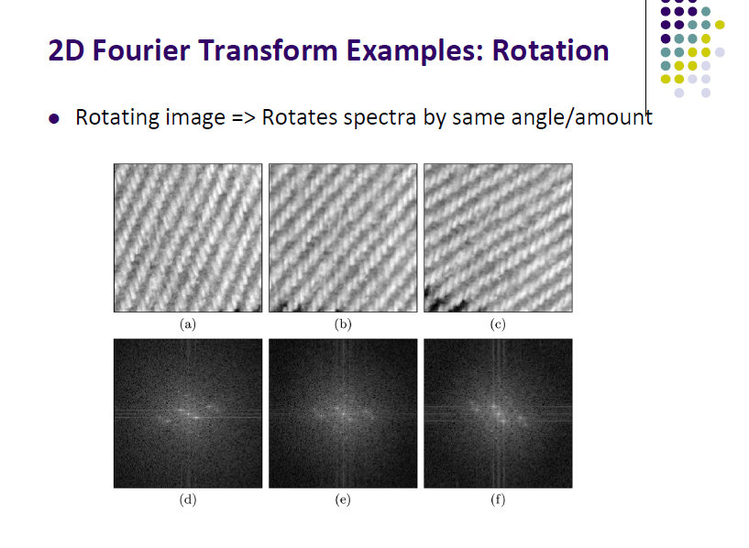

Slide 50
